Slide 1

Python MySql Connection
To create a connection between the MySQL database and the python application, the connect() method of mysql.connector module is used. Pass the database details like HostName, username, and the database password in the method call. The method returns the connection object.Python MySQL Connector is a Python driver that helps to integrate Python and MySQL. This Python MySQL library allows the conversion between Python and MySQL data types. MySQL Connector API is implemented using pure Python and does not require any third-party library.

Slide 2

Installation Of PIP
For connecting python with mysql we need to install some module.
Go to cmd>Run as administrator
Go to c:\users\admin\appdata\local\programs\Python\python311
Use python-m pip install mysql-connector-python

Slide 3
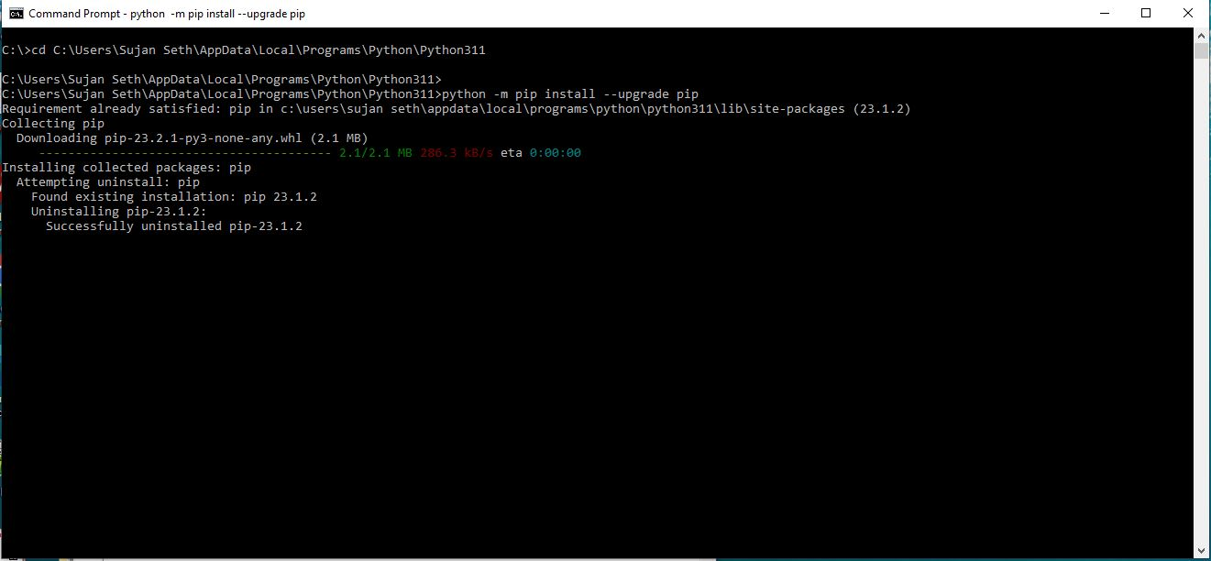

Slide 4
Installation Of MySqlConnector
For connecting python with mysql we need to install some module.
Go to cmd>Run as administrator
Go to c:\users\admin\appdata\local\programs\Python\python311
Use python-m pip install mysql-connector-python

Slide 5
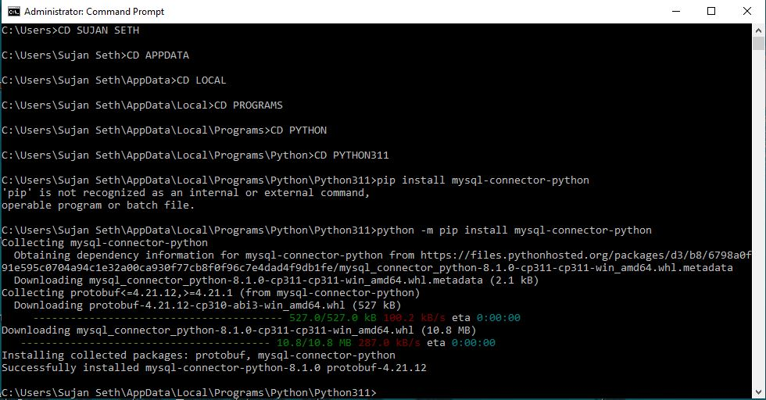

Slide 6
Installation of beautifultable Module
For connecting python with mysql we need to install some module.
Go to cmd>Run as administrator
Go to c:\users\admin\appdata\local\programs\Python\python311
Use python-m pip install beautifultable

Slide 7
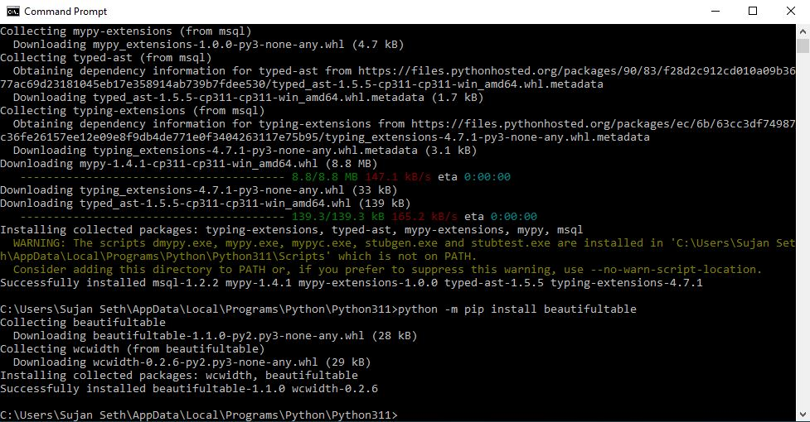

Slide 8
Making MYSQL Database

Slide 9
Creation of MYSql Database
Open Xamp or wamp and follow the follwing Steps
Create Database from New option from PHPMyadmin
Create Table With Suitable Name
Insert a Data

Slide 10
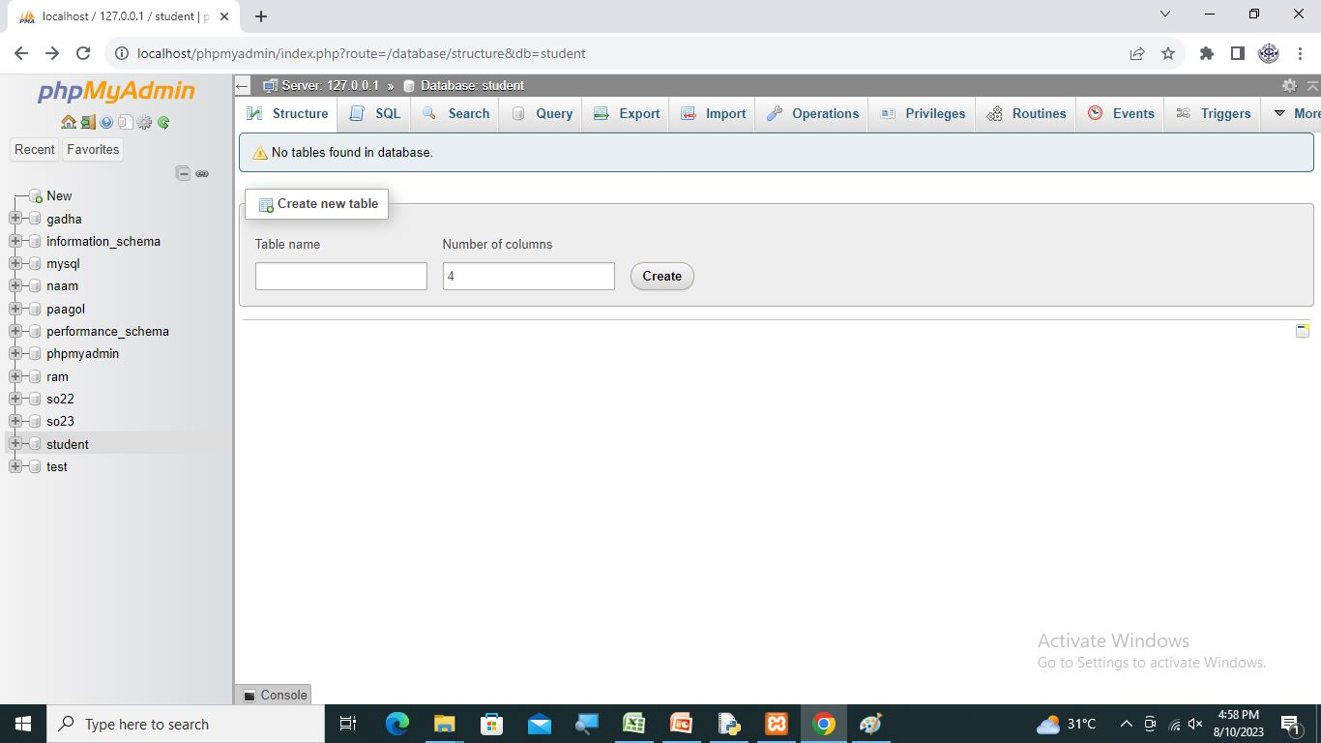

Slide 11
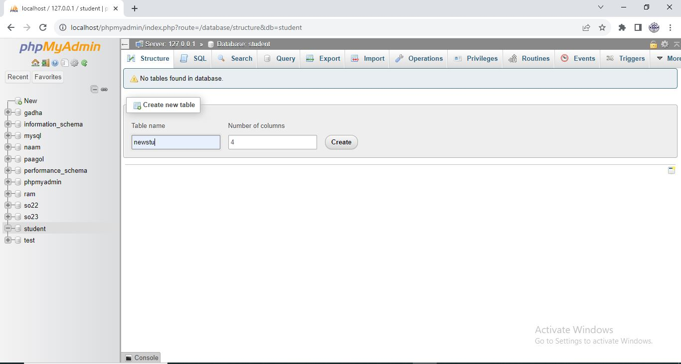

Slide 12
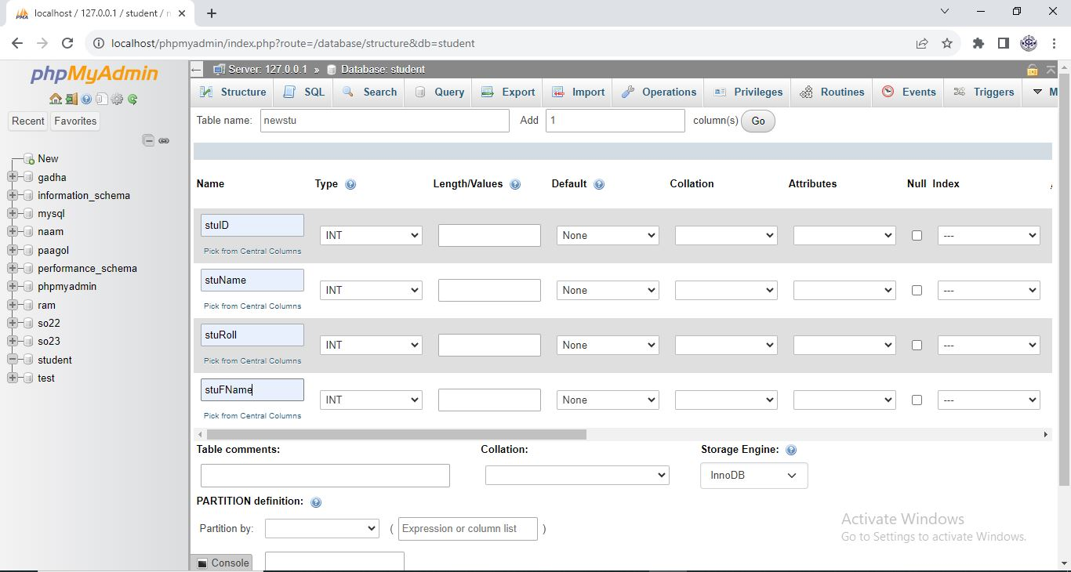

Slide 13
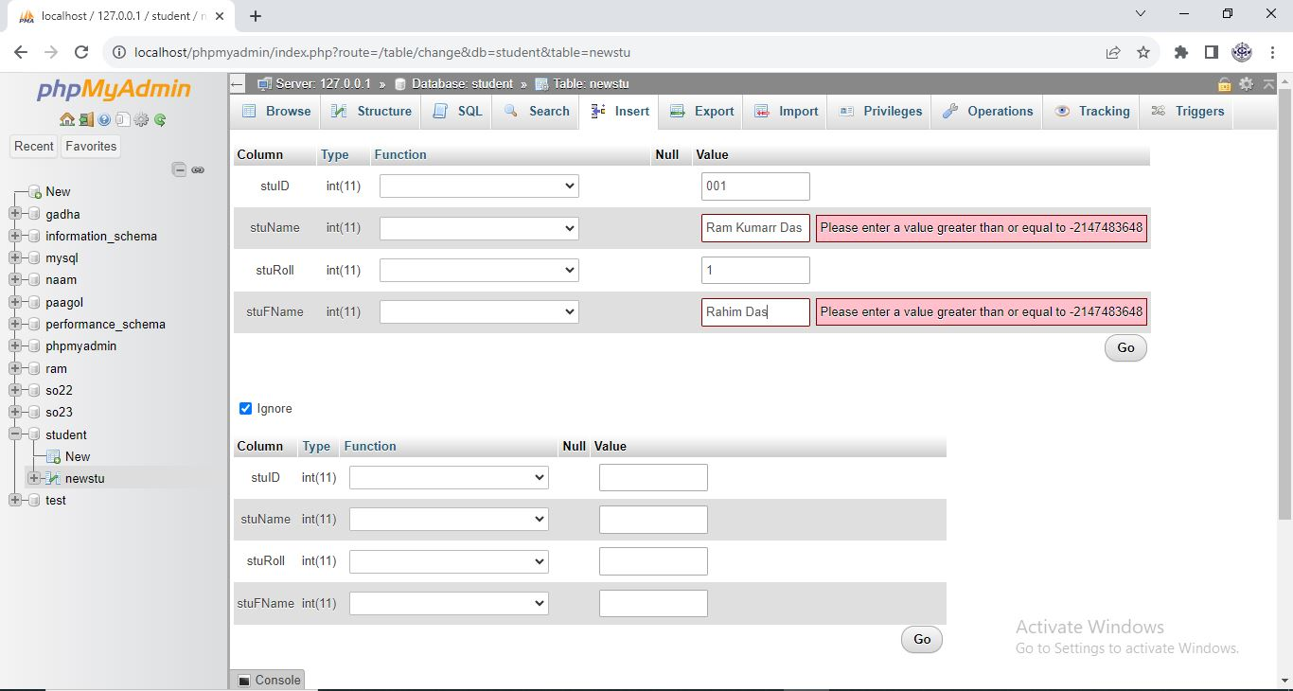

Slide 14
Output

Slide 15
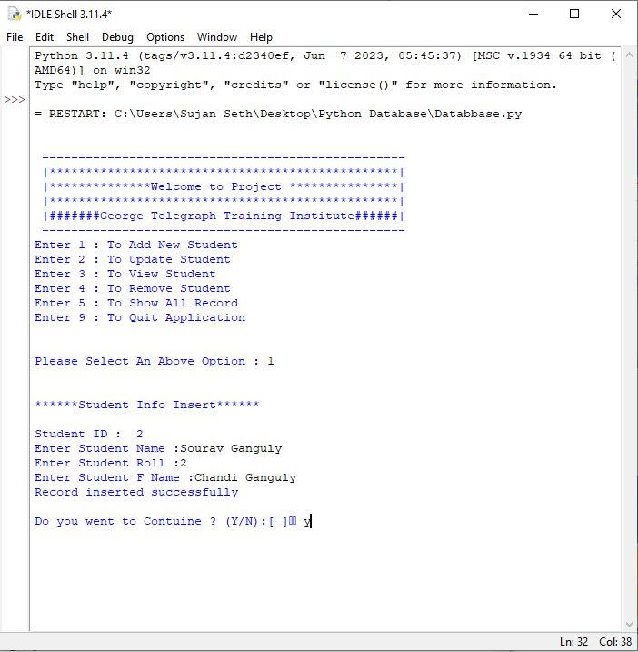

Slide 16


